Slide 1
Developing a software for dubbing of videos from English to other Indian regional languages
PIP4004 University Project
Review-1
Batch Number: CBD-G01
Under the Supervision of,
Dr. M Swapna
Associate Professor
School of Computer Science and Engineering
Presidency University
Roll Number | Student Name
20211CBD0042 20211CBD0044 20211CBD0045 20211CBD0049 | Gagan Raam S Udaya T K Anish R Gowda Venkata Sreevathsa G
Name of the Program: Computer Science And Technology [Big Data]
Name of the HoD: Dr. Pravinth Raja
Name of the Program Project Coordinator: Ms. Suma N G
Name of the School Project Coordinators: Dr. Sampath A K

Slide 2
Problem Statement Number: PCS-103
Organization: Ministry of Commerce and Industries
Category (Hardware / Software / Both) : Software
Problem Description: CIPAM is engaged in the creation of promotional and awareness videos on Intellectual Property in India. A software that can be used for dubbing of videos from English to other Indian regional languages would help in mass outreach of such videos for public awareness. The software must produce a voiceover (in a human like voice) in Indian vernacular languages like Hindi, Marathi, Bengali, Gujarati, Tamil, Telugu, etc. as well as text supers that is dubbed from English to other Indian regional languages. The translated voiceover must also be in simple language, easy to understand and must not be colloquial in nature.

Slide 3
Github Link
The Github link provided should have public access permission.
Github Link

Slide 4
Literature Survey
Real Time Machine Translation System between Indian Languages (2022) : This paper presents a real-time machine translation system for Indian languages, addressing linguistic diversity and computational challenges. It employs neural machine translation (NMT) techniques optimized for low-resource languages. The study evaluates translation quality, latency, and scalability, highlighting improvements in fluency and accuracy. The system facilitates seamless cross-lingual communication in India.
Neural Machine Translation for Low-Resourced Indian Languages (2020): The paper explores neural machine translation (NMT) techniques for low-resource Indian languages, addressing challenges like data scarcity and linguistic diversity. It investigates transfer learning, multilingual models, and synthetic data augmentation to improve translation quality. The study highlights the effectiveness of transformer-based architectures in enhancing translation accuracy for underrepresented Indian languages.
Statistical Machine Translation for Indic Languages (2023): The paper "Statistical Machine Translation for Indic Languages (2023)"explores statistical machine translation (SMT) approaches tailored for Indic languages. It discusses language-specific challenges, such as morphological richness and word-order variations. The study evaluates SMT models, compares them with neural machine translation (NMT), and suggests optimizations to improve translation accuracy for low-resource Indian languages.

Slide 5
Literature Survey
Vemula, V. V. B., Narne, P. K., Kudaravalli, M., Tharimela, P., & Prahallad, K. (2010). ANUVAADHAK: A Two-way, Indian Language Speech-to-Speech Translation System for Local Travel Information Assistance. International Journal of Engineering Science and Technology, 2(8), 3865-3873. : The ANUVAADHAK system presents a two-way speech-to-speech translation framework for Indian languages, focusing on local travel assistance. It integrates automatic speech recognition (ASR), machine translation (MT), and text-to-speech (TTS) synthesis. The study highlights challenges in Indian language translation, including syntax variations and phonetic diversity, emphasizing real-time usability in travel contexts.
Mhaskar, S., Bhat, V., Batheja, A., Deoghare, S., Choudhary, P., & Bhattacharyya, P. (2023). VAKTA-SETU: A Speech-to-Speech Machine Translation Service in Select Indic Languages. arXiv preprint arXiv:2305.12518. : Mhaskar et al. (2023) present ”VAKTA-SETU”, a speech-to-speech machine translation system for select Indic languages. The study focuses on overcoming linguistic challenges in Indian languages through deep learning models. It integrates automatic speech recognition (ASR), neural machine translation (NMT), and text-to-speech (TTS) synthesis, improving accessibility and real-time multilingual communication.

Slide 6
Literature Survey
Das, S. B., Biradar, A., Mishra, T. K., & Patra, B. K. (2022). Improving Multilingual Neural Machine Translation System for Indic Languages. arXiv preprint arXiv:2209.13279. : Das et al. (2022) explore advancements in multilingual neural machine translation (MNMT) for Indic languages, addressing low-resource challenges. They enhance translation quality through novel data augmentation, improved training strategies, and architecture refinements. Their study demonstrates significant performance gains, emphasizing the importance of linguistic diversity and transfer learning in MNMT systems.
Choudhary, H., Rao, S., & Rohilla, R. (2020). Neural Machine Translation for Low-Resourced Indian Languages. ACL Anthology. : Choudhary, Rao, and Rohilla (2020) explore neural machine translation (NMT) techniques for low-resourced Indian languages. The paper discusses challenges such as data scarcity and linguistic diversity, proposing optimized training strategies to enhance translation accuracy. Their findings highlight the importance of multilingual models and transfer learning in improving NMT performance for Indian languages.

Slide 7
Literature Survey
Gala, J., Chitale, P. A., Raghavan, A. K., Gumma, V., Doddapaneni, S., Kumar, A., Nawale, J., Sujatha, A., Puduppully, R., Raghavan, V., Kumar, P., Khapra, M. M., Dabre, R., & Kunchukuttan, A. (2023). IndicTrans2: Towards High-Quality and Accessible Machine Translation Models for all 22 Scheduled Indian Languages. arXiv preprint arXiv:2305.16307. : Gala et al. (2023) introduce “IndicTrans2”, a high-quality machine translation model for all 22 scheduled Indian languages. The paper enhances prior Indic models by leveraging “better data curation, model architecture improvements, and fine-tuning strategies”. IndicTrans2 outperforms existing translation systems, improving accessibility and usability for low-resource Indian languages.

Slide 8
Objectives
Accurate and Context-Aware Translation: Develop a software solution that translates English text into Hindi, Marathi, Bengali, Gujarati, Tamil, and Telugu while preserving the true meaning of the content rather than providing a literal word-to-word translation.
Multi-Format Text Processing: Enable the software to process and translate text from various formats, including Word documents, PDFs, and images containing embedded text, ensuring accessibility and ease of use.
Simplified and Clear Language Output: Ensure that the translated content is easy to understand, avoiding complex or overly technical language while maintaining clarity and accuracy for a diverse audience, including students, professionals, and the general public.
Enhanced Outreach and Awareness: Support CIPAM’s mission of promoting intellectual property rights (IPR) awareness by providing translated educational materials in regional languages, making them accessible to law enforcement, judiciary, businesses, and the general public.

Slide 9
Existing Methods Drawbacks
Traditional Rule-Based Machine Translation (RBMT): Uses phrase-based probability models, often leading to word-for-word translations with grammatical errors and unnatural sentence structures.
Neural Machine Translation (NMT) using Transformer models captures context better, resulting in more accurate and fluent translations, especially for low-resource Indian languages.
Classical Hidden Markov Model (HMM)-Based ASR: HMM-based ASR struggles with accents, background noise, and large vocabularies, reducing speech recognition accuracy.
NMT with attention mechanisms enhances sentence fluency by understanding the relationships between words, improving translation quality.
Basic Text-to-Speech (Concatenative and Formant-Based TTS): These TTS methods sound robotic, lack expressiveness, and fail to generate natural prosody.
Deep Neural Networks (DNNs) and Seq2Seq ASR models improve speech recognition accuracy by learning complex patterns and handling diverse accents better.
Statistical Machine Translation (SMT): Uses phrase-based probability models, often leading to word-for-word translations with grammatical errors and unnatural sentence structures.
WaveNet, Tacotron, and FastSpeech models generate human-like, expressive speech for better dubbing quality.

Slide 10
Existing Methods Drawbacks
Manual Subtitle Creation & Timestamping: Time-consuming and prone to errors in synchronization.
Automated speech-to-text with heuristic timestamping enables accurate and efficient subtitle alignment with video content.
Basic Video Processing Without AI-Based Synchronization: Manually merging translated audio with video results in synchronization issues.
FFmpeg’s Muxing algorithm ensures accurate merging of video, translated speech, and subtitles for a seamless viewing experience.
Direct YouTube Downloading Without Adaptive Streaming: Can result in poor quality if network conditions fluctuate, leading to inconsistent video and audio quality.
Adaptive Bitrate Streaming (ABR) with yt_dlp ensures the best-quality video and audio streams are downloaded dynamically based on available bandwidth.

Slide 11
Proposed Methods
YouTube Video Downloading: Uses Adaptive Bitrate Streaming (ABR) and yt_dlp’s video merging to download and process high-quality video and audio streams efficiently.
Audio Extraction from Video: Uses FFmpeg’s PCM S16LE codec to extract raw audio from video files, enabling further processing like speech recognition and translation while preserving high-quality sound.
Automatic Speech Recognition (ASR): ASR converts spoken language into text using Deep Neural Networks (DNNs), Hidden Markov Models (HMMs), and Seq2Seq models for accurate transcription, enabling applications like voice assistants, transcription, and dubbing.
Subtitling and Timestamping: Subtitling and timestamping involve ”speech-to-text conversion, sentence segmentation, and time synchronization” to align subtitles with video. Rule-based or AI-driven methods ensure accurate timing for readability in multimedia content like films and lectures.

Slide 12
Proposed Methods
Neural Machine Translation (NMT): NMT uses ”deep learning models like Transformer and Seq2Seq with attention” to translate text between languages. It improves accuracy by understanding context, making it ideal for low-resource language translation tasks.
Text-to-Speech (TTS): TTS converts text into natural-sounding speech using ”deep learning models like WaveNet, Tacotron, and FastSpeech”. It enhances accessibility, voice assistants, and dubbing by generating human-like, expressive speech synthesis.
Video Processing & Merging Audio/Video: Uses FFmpeg’s Muxing algorithm to combine video, translated audio, and subtitles into a single synchronized output, preserving media quality and ensuring seamless playback.
Document Creation: Uses Structured Text Processing algorithms in python-docx to format and generate translation documents, ensuring clear and organized multilingual content representation.

Slide 13
Modules
FFmpeg : Extracts audio from video, processes media, and merges translated audio with video.
SpeechRecognition: Converts spoken language into text using ASR techniques.
Googletrans: Translates extracted text into the target languages using NMT.
gTTS (Google Text-to-Speech): Converts translated text into natural-sounding speech.
docx (python-docx): Creates a structured document for translations.
docx (python-docx): Creates a structured document for translations.
yt_dlp: Downloads YouTube videos for processing.
Streamlit: Provides a user-friendly web interface for translation and video processing.
OS: Handles file management for saving and accessing media files.

Slide 14
Software Compononets
Technology Stack Components:
Language: Python, JavaScript
Google Cloud Text-to-Speech API: Used to generate the audio for the translated text.
Google Cloud Translate API: Used to translate the transcribed text into a different language.
Whisper ASR: Used to transcribe the audio from the video file.
Spacy: Used for natural language processing tasks, such as tokenization and syllable counting.
PyDub: Used for manipulating audio files.
MoviePy: Used for extracting the audio from the video file.

Slide 15
Hardware Requirements
Processor: Intel Core i7/i9 or AMD Ryzen 9
RAM: Minimum 8GB (32GB recommended for deep learning tasks)
GPU: NVIDIA RTX 3060 or higher (for AI model training and inference)
Storage: SSD (Minimum 500GB, NVMe recommended for faster video processing) or HDD (Minimum 1TB)
Audio Processing Hardware: High-quality microphone and audio interface (for custom voice recording and editing)
Additional Peripherals: Dual monitors for efficient workflow, graphics tablet

Slide 16
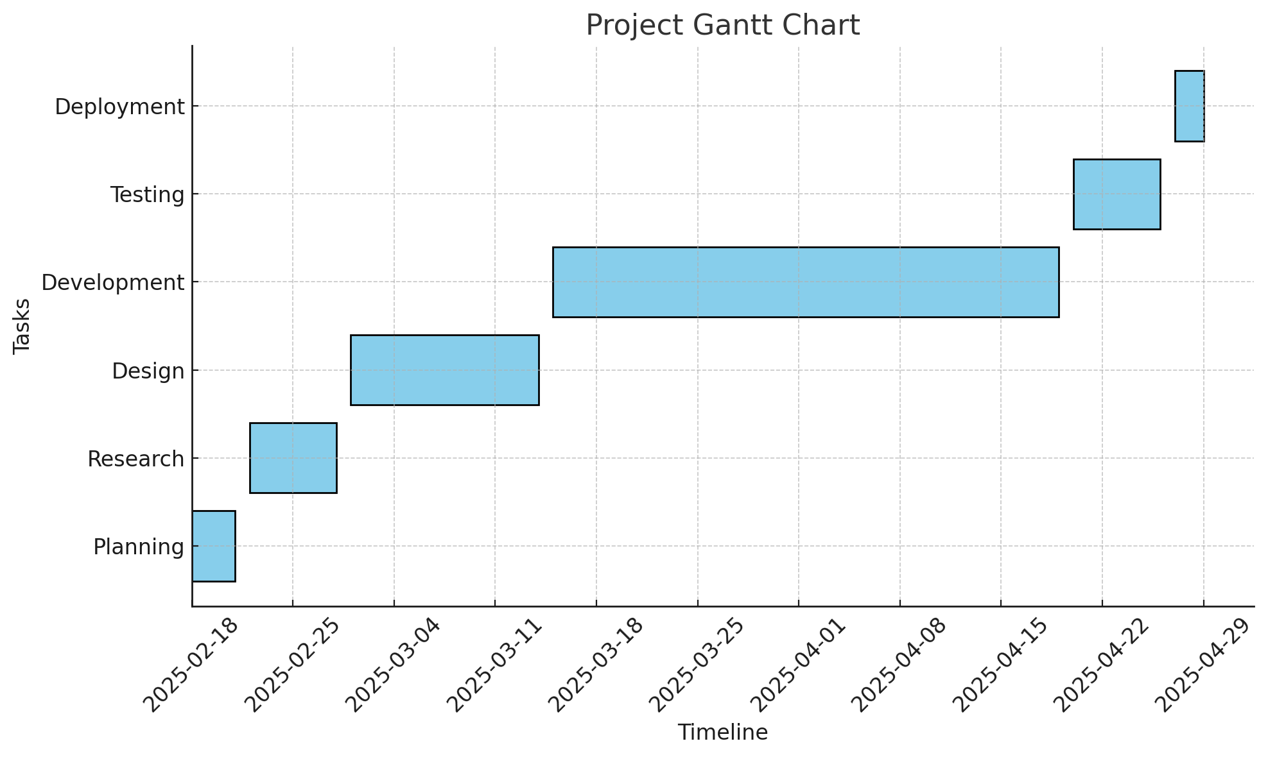
Timeline of the Project (Gantt Chart)
Planning Phase: February 18, 2025 – February 23, 2025
Research Phase: February 25, 2025 – March 2, 2025
Design Phase: March 3, 2025 – March 16, 2025
Development Phase: March 17, 2025 – April 19, 2025
Testing Phase: April 20, 2025 – April 26, 2025

Slide 17
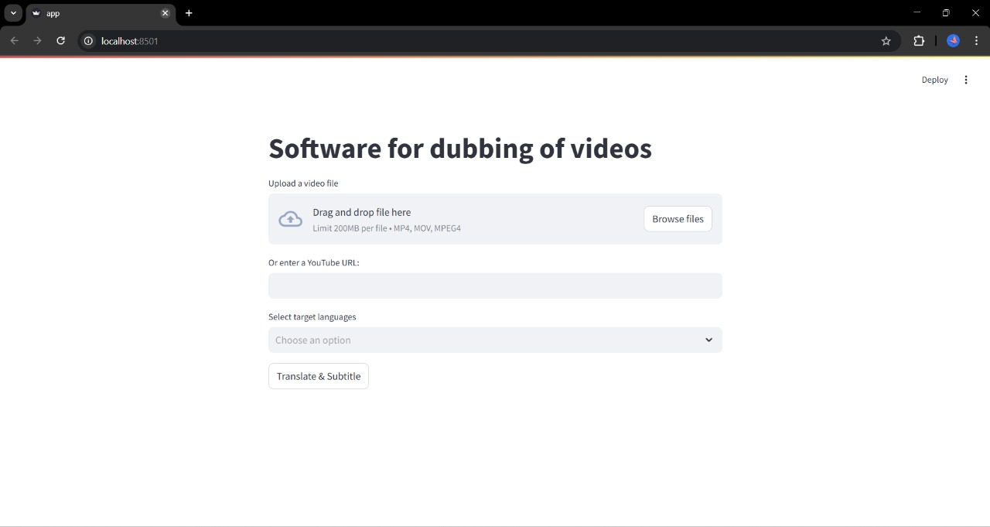
Outputs
The UI presents a "Software for dubbing of videos" interface. Users can drag and drop or browse a video file (max 200MB, MP4, MOV, MP3/4) or enter a YouTube URL. Users choose target Indian languages through a dropdown before they click "Translate & Subtitle."

Slide 18
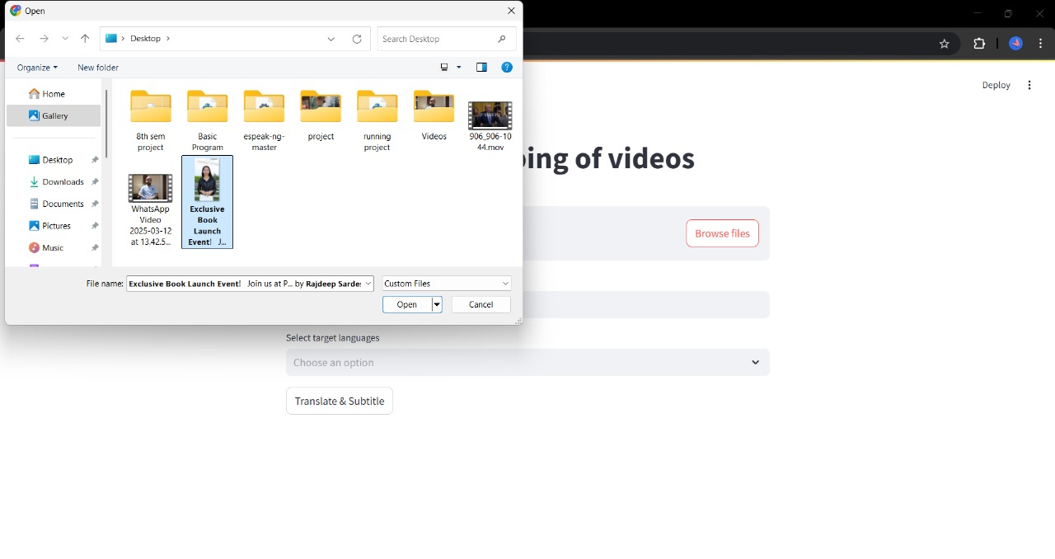
Output
The interface has been designed to allow users to upload video files (200MB maximum in MP4, MOV, MPEG4 formats) or input a YouTube URL. It also provides selection of target Indian languages through clickable tags (hi, gu, pa, mr, etc.). An announcement for the event is given, and a "Translate & Subtitle" button starts the process of dubbing. The software intends to make video dubbing into Indian languages easier.

Slide 19
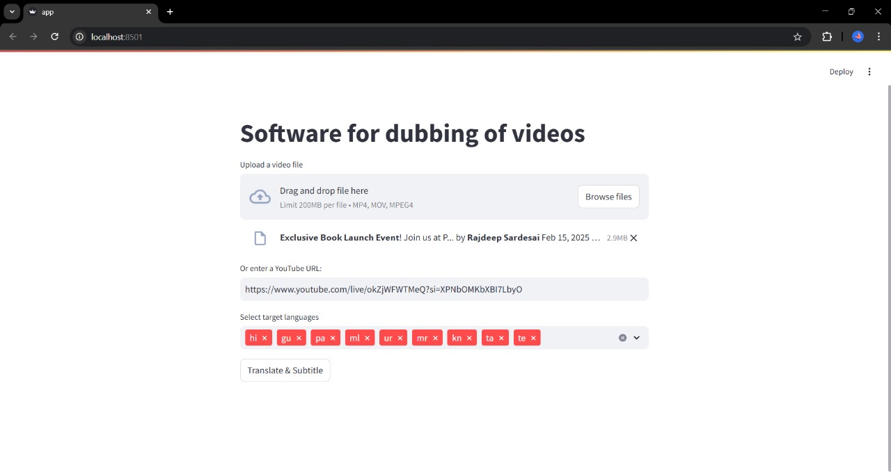
Output
The screenshot shows a UI for video dubbing software. Users are able to upload a video file (with certain size and format restrictions) or paste a YouTube URL, as demonstrated with a particular link pasted. Various target Indian languages (Hindi, Gujarati, Punjabi, etc.) are chosen through clickable tags. A notice reading "Exclusive Book Launch Event" is also apparent, indicating possible integration or advertisement within the platform. Lastly, a "Translate & Subtitle" button launches the dubbing process.

Slide 20
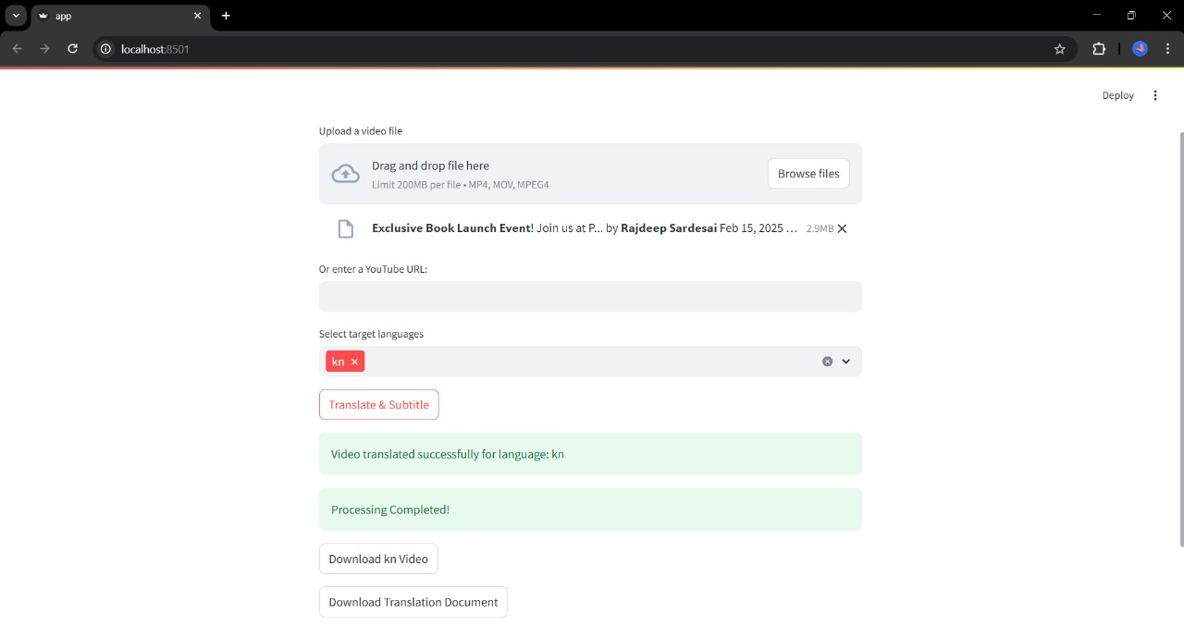
Output
This image is the screen of a video dubbing software after processing. The user first could upload a video file or insert a YouTube URL. A notice for an "Exclusive Book Launch Event" was displayed. The user chose "kn" (Kannada) as the target language and clicked "Translate & Subtitle". The interface now shows two green success messages: "Video translated successfully for language: kn" and "Processing Completed!" Below these, there are two download options: "Download Translated Video" and "Download Translation Document." This shows the software has successfully dubbed the input video into Kannada, and the user can now download the translated video and possibly a separate translation document.

Slide 21
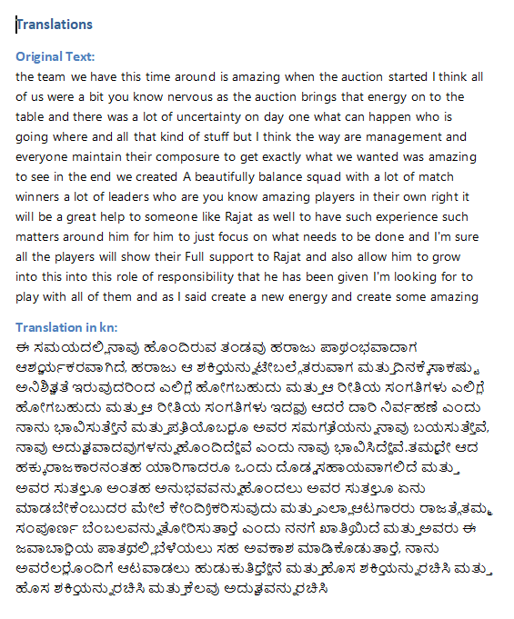
Output
This screenshot displays the transcript of another dubbed video. It is the dubbed transcript from English to Kannada of an individul’s insight on RCB’s 2025 auction and naming Rajat Patidar as the franchise’s Captain.

Slide 22
References
Real Time Machine Translation System between Indian Languages (2022)
Neural Machine Translation for Low-Resourced Indian Languages (2020)
Statistical Machine Translation for Indic Languages (2023)
Vemula, V. V. B., Narne, P. K., Kudaravalli, M., Tharimela, P., & Prahallad, K. (2010). ANUVAADHAK: A Two-way, Indian Language Speech-to-Speech Translation System for Local Travel Information Assistance. International Journal of Engineering Science and Technology, 2(8), 3865-3873.
Mhaskar, S., Bhat, V., Batheja, A., Deoghare, S., Choudhary, P., & Bhattacharyya, P. (2023). VAKTA-SETU: A Speech-to-Speech Machine Translation Service in Select Indic Languages. arXiv preprint arXiv:2305.12518.
Das, S. B., Biradar, A., Mishra, T. K., & Patra, B. K. (2022). Improving Multilingual Neural Machine Translation System for Indic Languages. arXiv preprint arXiv:2209.13279.
Choudhary, H., Rao, S., & Rohilla, R. (2020). Neural Machine Translation for Low-Resourced Indian Languages. ACL Anthology.
Gala, J., Chitale, P. A., Raghavan, A. K., Gumma, V., Doddapaneni, S., Kumar, A., Nawale, J., Sujatha, A., Puduppully, R., Raghavan, V., Kumar, P., Khapra, M. M., Dabre, R., & Kunchukuttan, A. (2023). IndicTrans2: Towards High-Quality and Accessible Machine Translation Models for all 22 Scheduled Indian Languages. arXiv preprint arXiv:2305.16307.

Slide 23


